Slide 1
CS 470 Project Two Conference Presentation: Cloud Development
Samuel Bailey
October/2021

Slide 2

Overview
Welcome!
Notes:
Introduce myself. Purpose of presentation is to explain the infrastructure decisions we came up with while creating this project.

Slide 3
Containerization
What is containerization?
How does it work?
What tools are necessary for containerization?
Notes:
Most people in the world today use containers to put applications into the real world. Instead of running applications on VM inside of a server we use a container which is similar but has it’s differences. Containers are light weight and fast, they only have exactly what we need so all exploits are from us and not the OS.

Slide 4
Orchestration
What is the value of using Docker Compose?
Notes:
Container orchestration value and different products. Explain how they came to be and the purpose of them.

Slide 5

The Serverless Cloud
Serverless
What is “serverless” and what are its advantages?
What is S3 storage and how does it compare to local storage?
Notes:
Explaining what is the cloud and why it matters to the world. What it is systematically and why companies use it.

Slide 6
The Serverless Cloud
API & Lambda
Advantages of using a serverless API.
Inner workings of Lambda API Logic.
What scripts do we use to make this happen?
What are the steps needed to integrate the front end and backend?
Notes:
Explain the products of the cloud and why they’re needed in the world, how to make and use API’s

Slide 7
The Serverless Cloud
Database
MongoDB vs DynamoDB?
Queries we are using?
What scripts are produced in order to make this happen?
Notes:
Differences in databases queries to use them and what scripts we use to make them happen

Slide 8
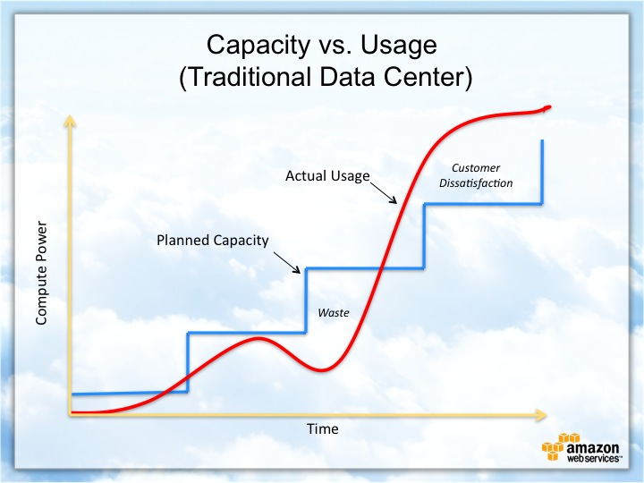
Cloud-Based Development Principles
Elasticity
Pay-for-use model
Notes:
Explaining pay as you go features, why we have them and the pros and cons.

Slide 9
Securing Your Cloud App
Access
Policies
API Security
How can you prevent unauthorized access?
Roles and Policies
Custom policies?
How can you secure the connection between Lambda and Gateway?
Lambda and the database
S3 Bucket
Notes:
How to secure your cloud with access and difference between policies.

Slide 10
Conclusion
Containers
‘The Cloud’
Security
Thank you for your time.
Notes:
Ending conclusion, thanks for coming.

